Slide 1

Learning Preference Inventory
Number your paper 1 – 14, for each questions choose the answer that best describes you.
Illustrated by Mary-Lynn Goberis
Directly from
https://www.gadoe.org/Curriculum-Instruction-and-
Assessment/Special-Education-Services/Documents/
IDEAS%202014%20Handouts/LearningStyleInventory.pdf
Adapted from, Learning to Study Through Critical Thinking,
J.A. Beatrice

Slide 2


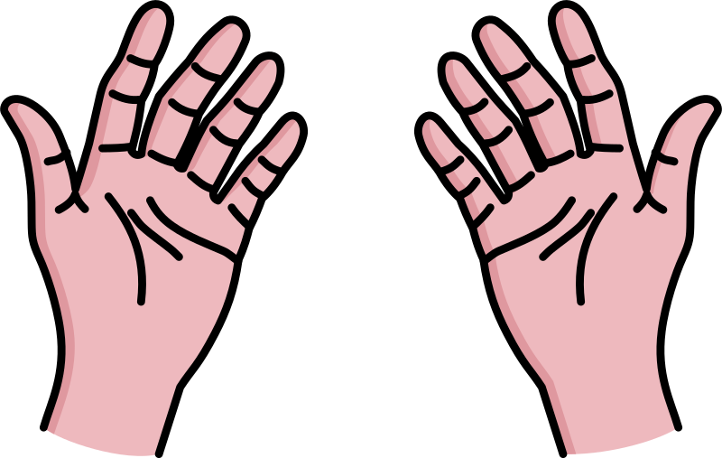
To learn something new
A B C
Notes:
1. If I have to learn how to do something, I learn best when I: (V) Watch someone show me how. (A) Hear someone tell me how. (K) Try to do it myself.

Slide 3


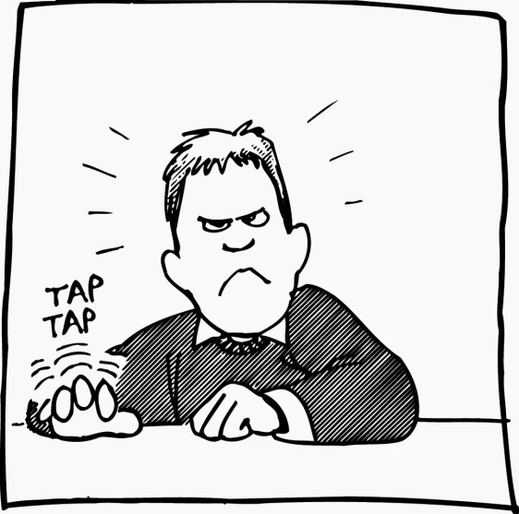
When I read
A B C
Notes:
2. When I read, I often find that I: (V) Visualize what I am reading in my mind’s eye. (A) Read out loud or hear the words inside my head. (K) Fidget and try to “feel” the content.

Slide 4
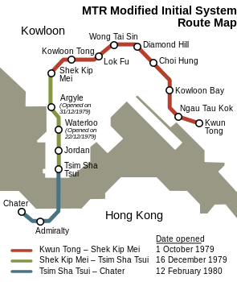

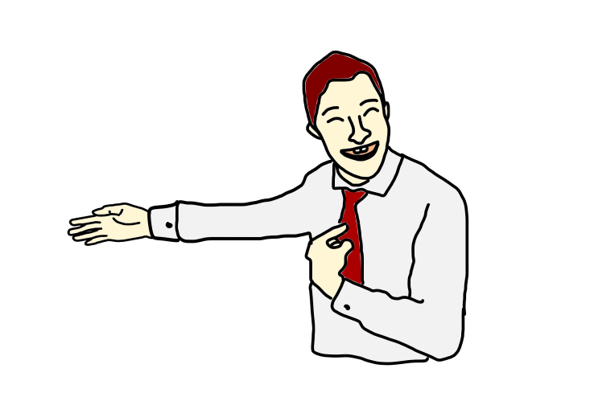
When giving directions
A B C
Notes:
3. When asked to give directions, I: (V) See the actual places in my mind as I say them or prefer to draw them. (A) Have no difficulty in giving them verbally. (K) Have to point or move my body as I give them.

Slide 5



Unsure about spelling
A B C
Notes:
4. If I am unsure how to (V) Write it in order to determine if it looks right. (A) Spell it out loud in order to determine if it sounds right. (K) Write it in order to determine if it feels right.

Slide 6
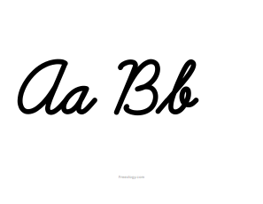
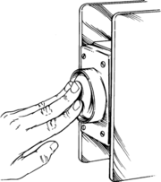
When I write
A B C
Notes:
5. When I write I: (V) Am concerned with how neat and well spaced my letters and words appear. (A) Often say the letters and words to myself. (K) Push hard on my part or pencil and can feel the flow of the words.

Slide 7


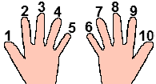
I remember a list
A B C
Notes:
6. If I had to remember a list of items, I would remember it best if: (V) Wrote them down. (A) Said them over and over to myself. (K) Move around and used my fingers to name each item.

Slide 8



I prefer teachers who
A B C
Notes:
7. I prefer teachers who: (V) Use a board or overhead projector while they lecture. (A) Talk with lots of expression. (K) Use hands­ on activities.

Slide 9



When trying to concentrate, I find it difficult when …
A B C
Notes:
8. When trying to concentrate, I have a difficult time when: (V) There is a lot of clutter or movement in the room. (A) There is a lot of noise in the room. (K) I have to sit still for any length of time.

Slide 10
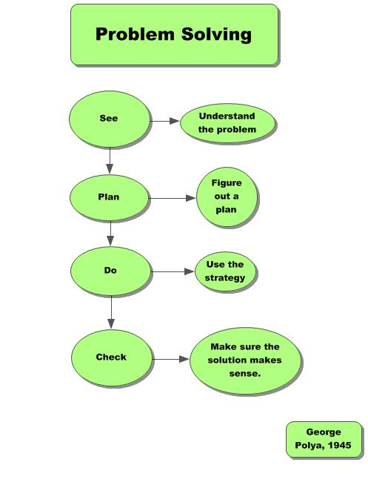


When solving a problem
A B C
Notes:
9. When solving a problem I: (V) Write or draw diagrams to see it. (A) Talk myself through it. (K) Use my entire body or move objects to help me think.

Slide 11



With written instructions on how to build something
A B C
Notes:
10. When given written instructions on how to build something, I: (V) Read them silently and try to visualize how the parts will fit together. (A) Read them out loud and talk to myself as I put the part together. (K) Try to put the parts together first and read later.

Slide 12


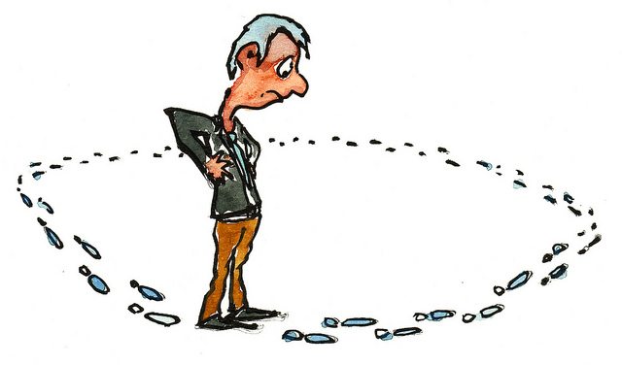
While waiting
A B C
Notes:
11. To keep occupied while waiting, I: (V) Look around, stare, or read. (A) Talk or listen to others. (K) Walk around, manipulate things with my hands, or move/shake my feet as I sit.

Slide 13
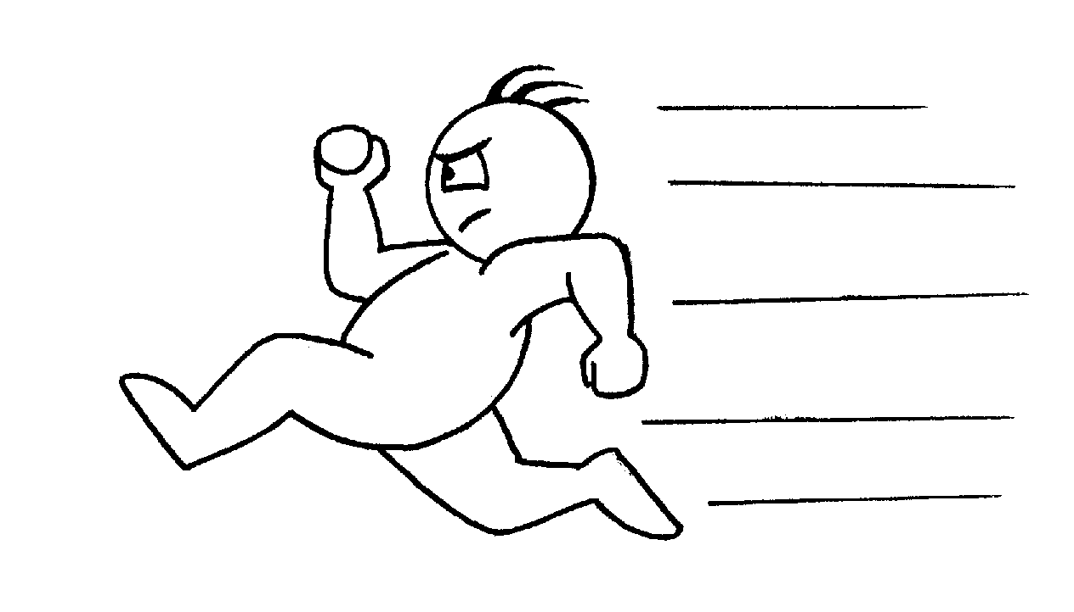


Verbally describe something
A B C
Notes:
12. If I had to verbally describe something to another person, I would: (V) Be brief because I do not like to talk at length. (A) Go into great detail because I like to talk. (K) Gesture and move around while talking.

Slide 14


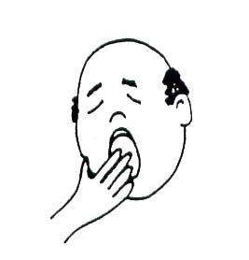
If someone was describing something
A B C
Notes:
13. If someone were verbally describing something to another person, I would: (V) Try to visualize what he/she was saying. (A) Enjoy listening but want to interrupt and talk myself. (K) Become bored if her/his description got too long and detailed.

Slide 15



When recalling names
A B C
Notes:
14. When trying to recall names, I remember: (V) Faces but forget names. (A) Names, but forget faces. (K) The situation where I met the person rather than the person’s name or face.

Slide 16
Add up A, B, & C’s
A = ___
B = ___
C = ___
Notes:
Scoring instructions: Add the number of responses for each letter and enter the total below. The area with the highest number of responses is your primary mode of learning.

Slide 17

Learning Preference Study Strategies
A =
B =
C =

Slide 18
VISUAL LEARNER
Organize work and living space to avoid distractions.
Sit in the front of the room to avoid distraction and away from doors or windows where action takes place.
Sit away from wall maps or bulletin boards.
Use neatly organized or typed material.
Use visual association, imagery, written repetition, flash cards, and clustering strategies for improved memory.
Reconstruct images in different ways: try different spatial arrangements and take advantage of blank spaces on the page.
Use note pads, Post­Its, to­-do lists, and other forms of reminders.
Use organizational format outlining for recording notes.
Use underlining, highlighting in different colors, symbols, flow charts, graphs, or pictures in your notes.
Practice turning visual cues back into words as you prepare for exams.
Allow sufficient time for planning and recording thoughts when doing problem­-solving tasks.
Use test preparation strategies that emphasize organization of information and visual encoding and recall.
Participate actively in class or group activities.
Develop written or pictorial outlines of responses before answering essay questions.

Slide 19
Auditory Learner
Work in quiet areas to reduce distractions, avoiding areas with conversation, music, and TV.
Sit away from doors or windows where noises may enter the classroom.
Rehearse information orally.
Attend lectures and tutorials regularly. Discuss topics with other students, professors and GTAs. Ask others to hear your understanding of the material.
Use mnemonics, rhymes, jingles, and auditory repetition through tape recording to improve memory.
Practice verbal interaction to improve motivation and self-­monitoring.
Use tape recorders to document lectures and for reading materials.
Remember to examine illustrations in textbooks and convert them into verbal descriptions.
Read the directions for tests or assignments aloud, or have someone read them to you, especially if the directions are long and complicated.
Remind yourself to review details.
Use time managers and translate written appointment reminders into verbal cues.
Use verbal brainstorming and tape recording writing and proofing.
Leave spaces in your lecture notes for later recall and 'filing'.
Expand your notes by talking with others and collecting notes from the textbook.
Read your notes aloud.
Practice writing your answers using old exams and speak your answers.

Slide 20
KINESTHETIC LEARNER
Keep verbal discourse short and to the point.
Actively participate in discussions.
Use all of your senses ­ sight, touch, taste, smell, hearing. Use direct involvement, physical manipulation, imagery, and "hands on" activities to improve motivation, interest, and memory.
Organize information into the steps that were used to physically complete a task.
Seek out courses that have laboratories, field trips, etc. and lecturers who give real life examples.
Use case studies and applications (example) to help with principles and abstract concepts.
Allow for physical action in solving problems.
Read or summarize directions, especially if they are lengthy and complicated, to discourage starting a task without instructions.
Use taped reading materials.
Use practice, play acting, and modeling to prepare for tests.
Allow for physical movement and periodic breaks during tests, while reading, or while composing written assignments.
Role play the exam situation.
Teach the material to someone else.
Write practice answers, paragraphs or essays.

Slide 21
BIBLIOGRAPHY
https://www.gadoe.org/Curriculum-Instruction-and-Assessment/Special-Education-Services/Documents/IDEAS%202014%20Handouts/LearningStyleInventory.pdf

